Slide 1
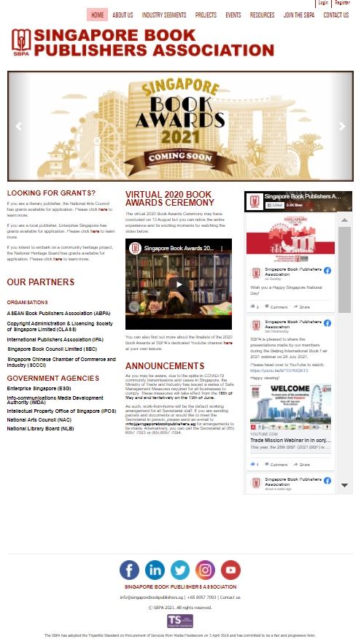

Home Page
singaporebookpublishers.sg
Link to :
bookbazaar.sg

Slide 2
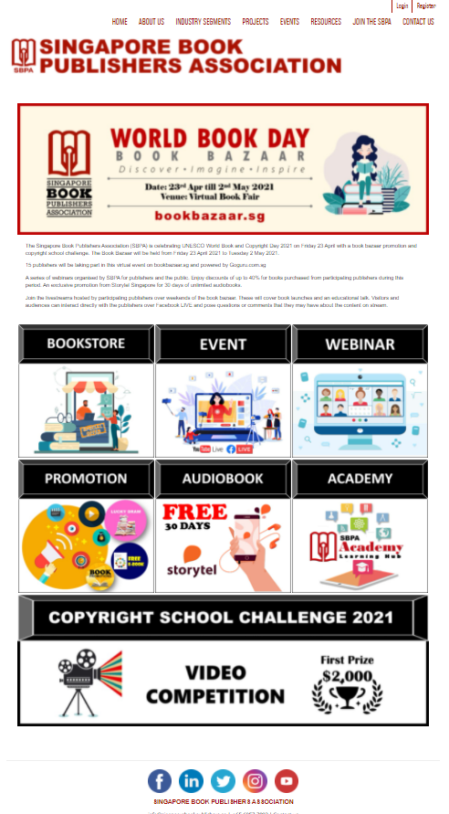
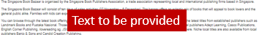
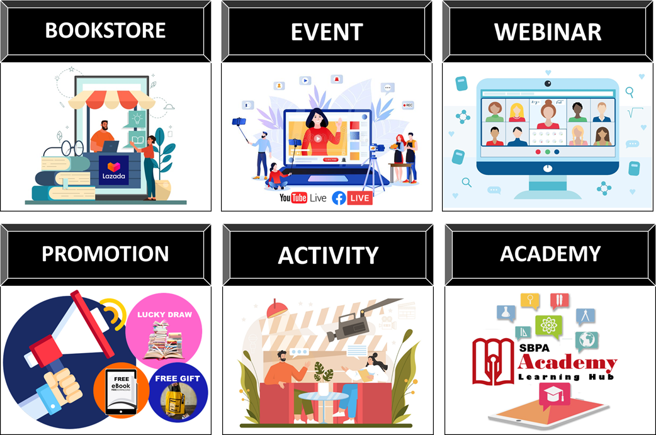

Landing Page
bookbazaar.sg

Slide 3
https://c.lazada.sg/t/c.bsj0OV?url=https%3A%2F%2Fpages.lazada.sg%2Fwow%2Fgcp%2Froute%2Flazada%2Fsg%2Fupr_1000345_lazada%2Fchannel%2Fsg%2Fupr-router%2Fsg%3Fhybrid%3D1%26data_prefetch%3Dtrue%26prefetch_replace%3D1%26at_iframe%3D1%26wh_pid%3D%2Flazada%2Fchannel%2Fsg%2Fbau-campaigns%2Fmother-tongue-book-bazaar
https://forms.gle/rJTNNAqmneUSbvBMA

Slide 4


Icon 2 - Event
Follow us on our Facebook or subscribe our YouTube channel to catch our LIVE stream.

Slide 5






Link to Facebook: https://www.facebook.com/sbpa.sg/

Slide 6


Icon 3 - Webinar
These webinars are conducted via zoom and it requires registration. Link: https://forms.gle/dwyuk3ingapxBuV6A
Link to :
https://forms.gle/dwyuk3ingapxBuV6A

Slide 7








Icon 4 - Promotion

Slide 8
1) Free Gift – Tote Bag
https://forms.gle/WKXQ22zxCKoHtEA47
2) To Win
https://forms.gle/Yx6WSqYwXYVK4EbJ9
3) Book Subscription
https://forms.gle/KAYGqSrWXjQ2Y9Vc8
4 & 5) Free E book
https://forms.gle/hZe2GxaH1woof9JR7
6) Vote & Win
https://www.surveylegend.com/s/39xz

Slide 9


Icon 5 - Activity

Slide 10










Slide 11

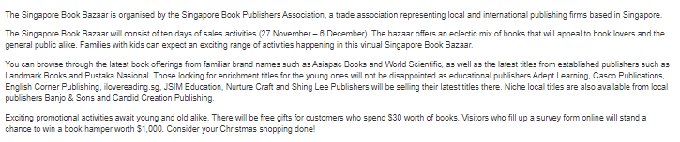
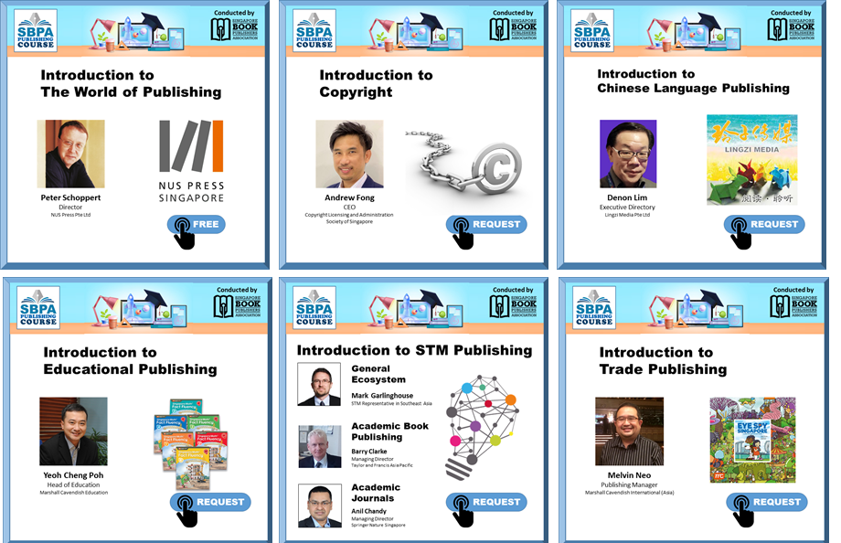
Icon 6 – SBPA Academy
Text to be provided

Slide 12
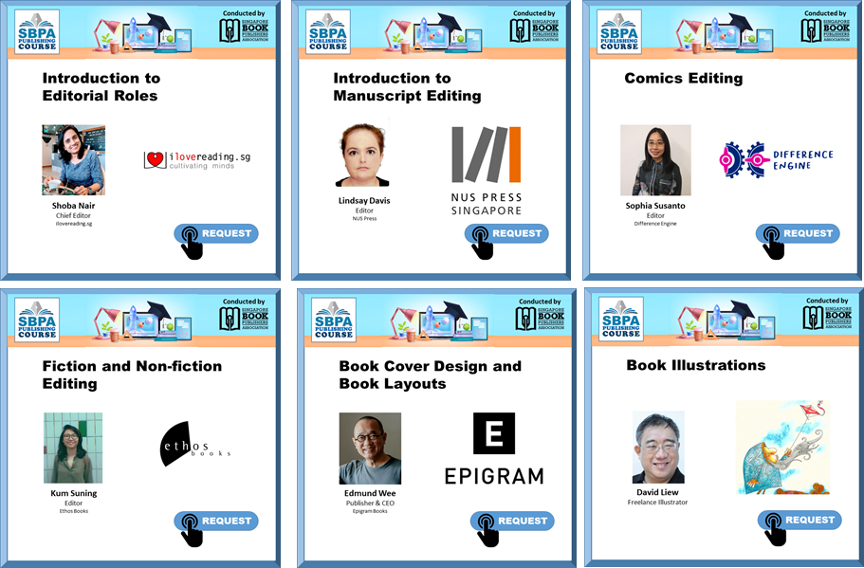
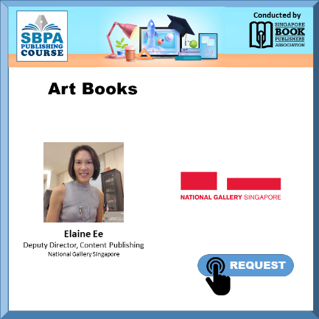
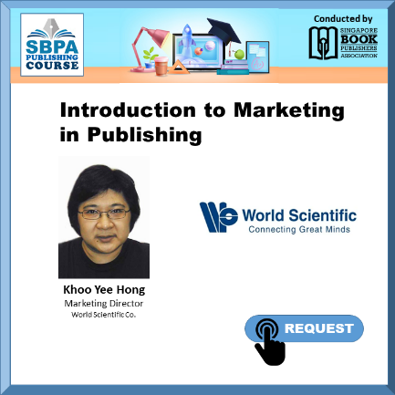
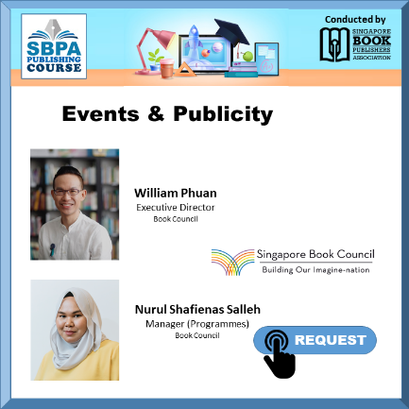
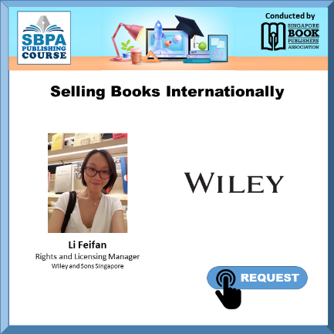

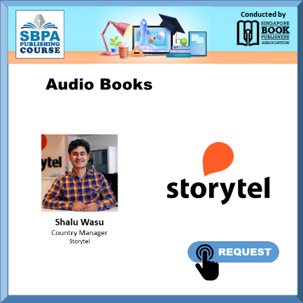
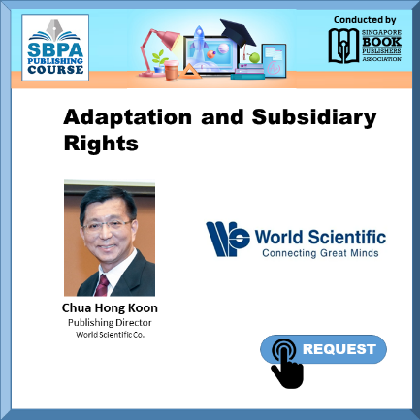
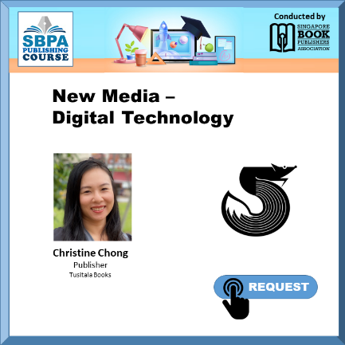

Slide 13

Link: https://youtu.be/64H6ui0KfFo
Please link the rest to the request form:
https://forms.gle/cmyY1P5a5VKLSWVFA

